Slide 1
Capstone Project Customer Purchase Intent Prediction
Team members :
Prateek Tripathi
Ranjanipriya
Rituraj Anand
Sai Venkat
Industry : Retail
Problem type : Classification

Slide 2

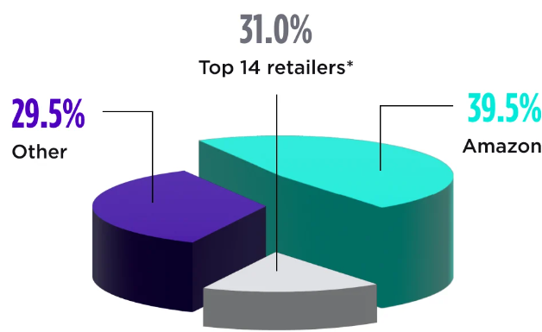
Introduction and Problem Statement
Introduction:
The retail industry must undergo significant shifts in data-driven strategies to enhance revenue streams and elevate brand visibility.
JCPenney, an e-commerce leader which made $1 billion in 2006 as its milestone failed to sustain its digital channel made it bankrupt. Project Liabilities- $4 Billion
Problem Statement:
Amazon, the e-commerce marketplace holds 39.5 % of the market share in the online retail market in India.
The company observed a 7.15% decline in sales during the year 2022-23 and a notable increase in the cart abandonment.

Slide 3
Business Objectives
Amazon India (AMZN) Online Shopping
WHAT?
Optimization of customer intent for a purchase on a real time basis.
WHY?
To increase the profitability by 1.5%
Decrease the Cart Abandonment by 13 %.
Decrease the Bounce and Exit Rate by 8%.
HOW?
Building a classification model that predicts the intent of customers for a purchase and reduce the cart abandonments.
MOTIVATION
The Net profits in FY23 dropped by 3.66%
Customer retention decreased in FY23 by 1.54%.

Slide 4
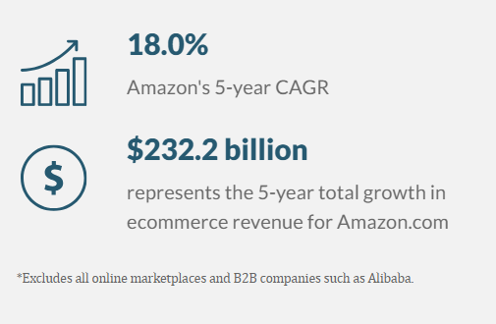
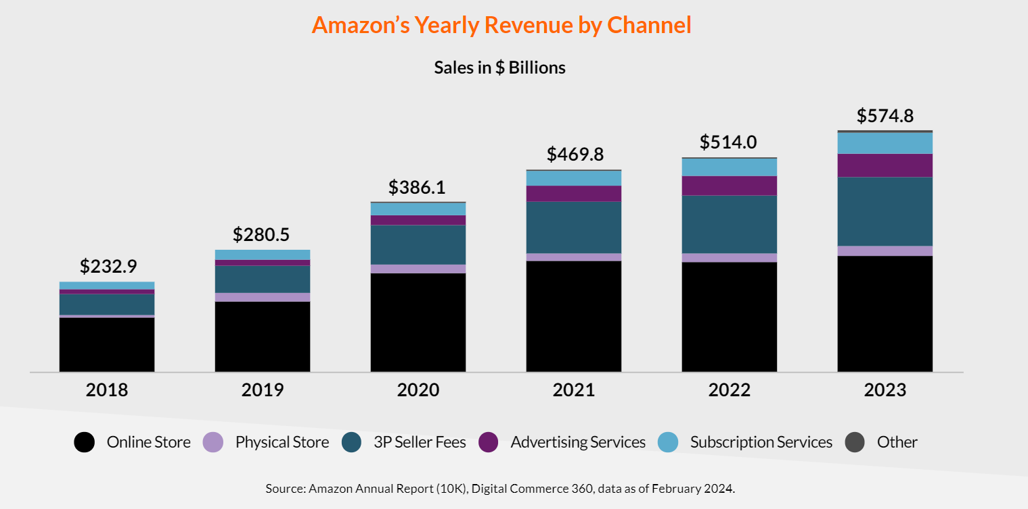
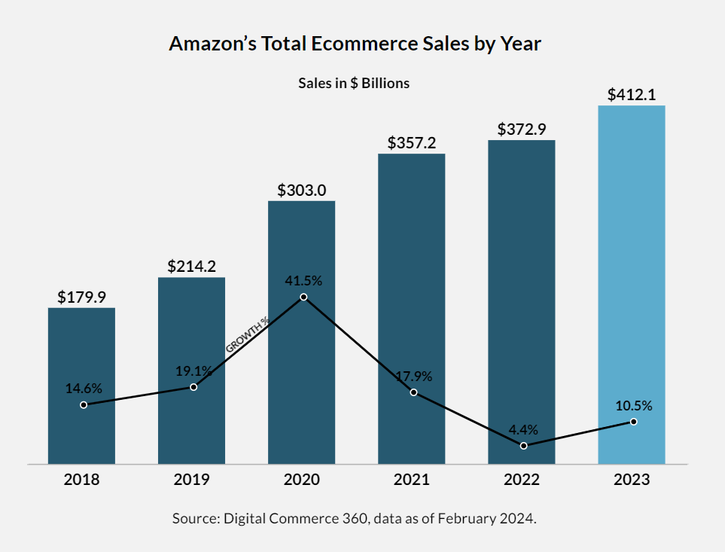
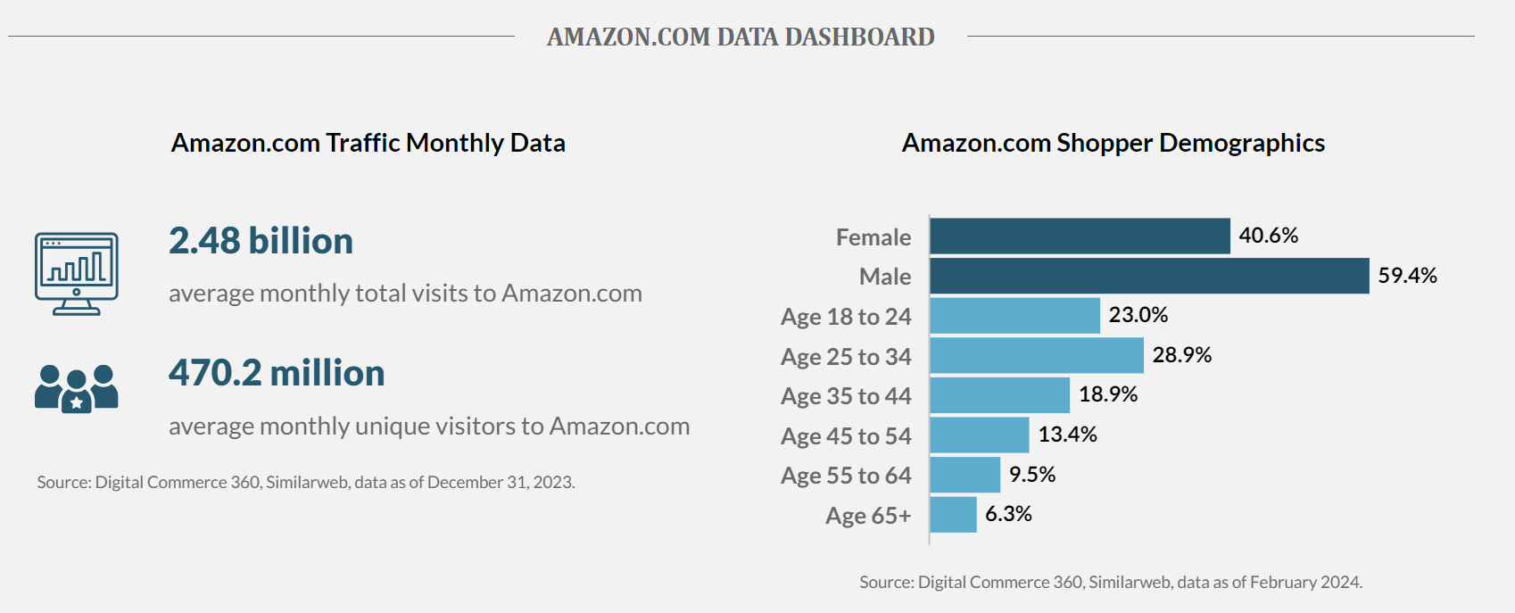
Industry trends and market demand – Amazon and its competitors
MMTCO2 – Million Metric Tons

Slide 5
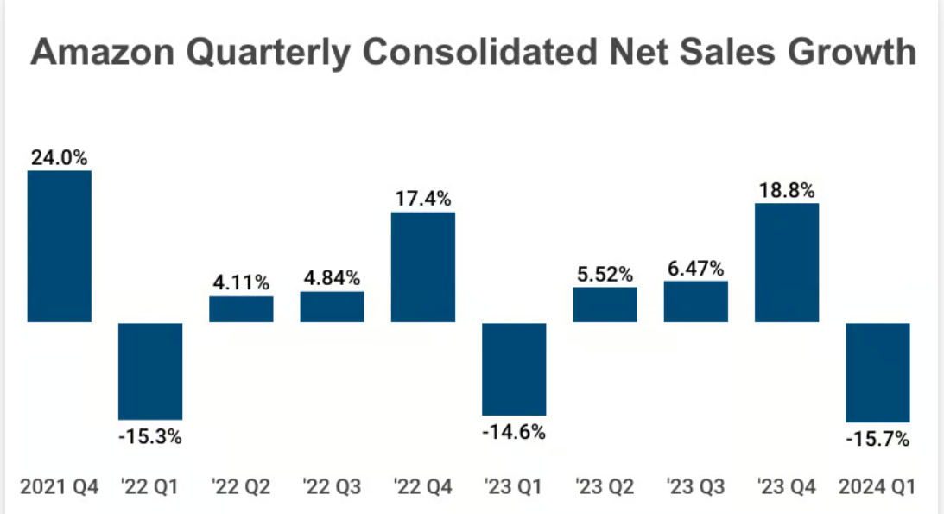
Industry trends and market demand – Amazon and its competitors

Slide 6


Data Engineering
Key Performance Indicators
Accuracy of the Model (Direct KPI)
Conversion Rate
Increase in Customer Engagement Metrics
Bounce Rate and Exit Rate
Page Value
Dimensions
Measures
Number of transactions,
Average session length,
Cart Abandonment Rate, Conversion rates by demographic and behavior.
Product categories, customer segments, session times

Slide 7
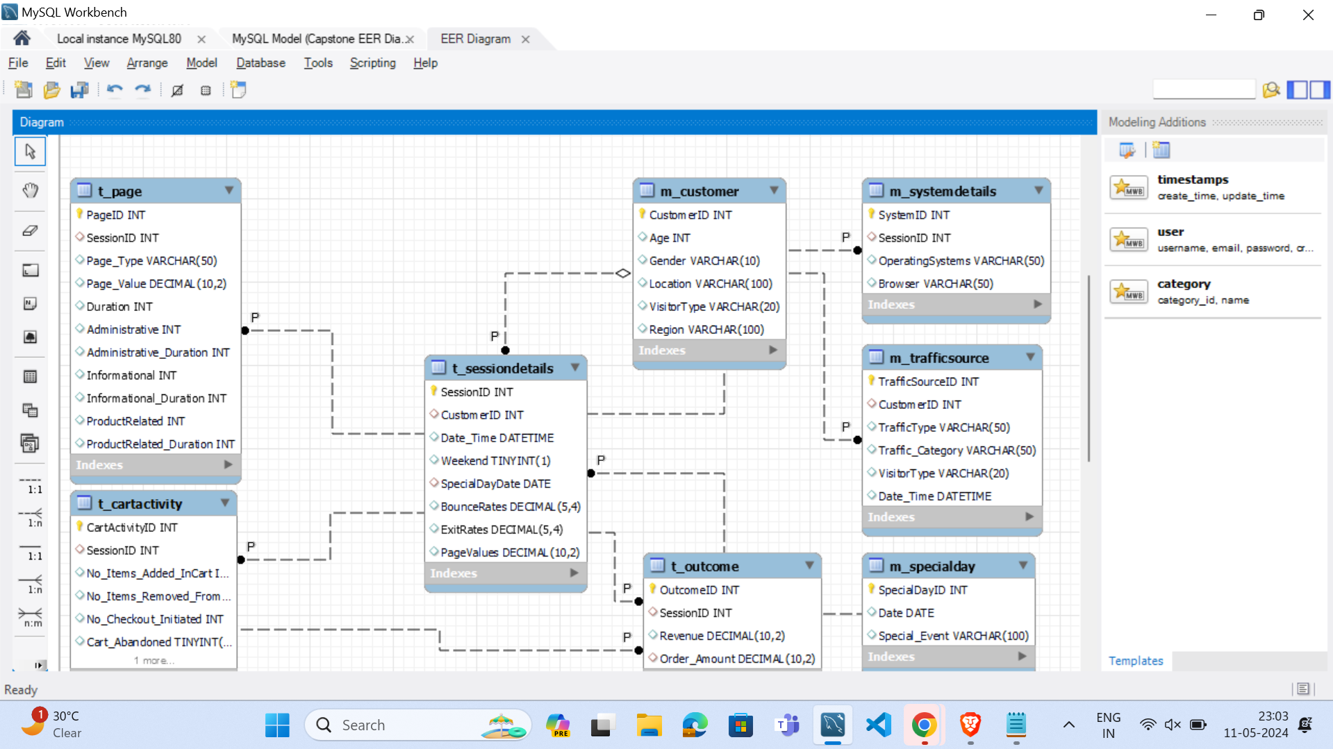
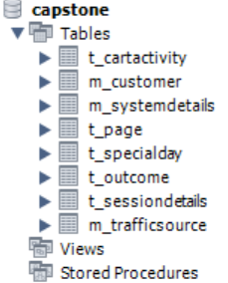
Data Schema

Slide 8
EDA Insights
Drop in sales after April (steep drop in revenue) happened after that in December. Higher sales are there.
On Weekdays, Wednesday witnesses the highest sales.
Weekend sale is very high.
Returning visitors has highest revenue.
Skewness removal through log transformation.
Page values ​​is the most important feature.
For further insights:
https://app.powerbi.com/links/YPvu2bNM5-?ctid=4d88e08a-ac18-4c08-9e77-08137ca36ebc&pbi_source=linkShare&bookmarkGuid=fcc51f5b-e910-423d-b4ed-c7361a61ecf7

Slide 9
Model Analysis
Model | Interpretability | Performance | Scalability | Ease of Implementation | Recommendation
Logistic Regression | High | Moderate | High | Easy | Suitable for simple problems with linearly separable data. May not capture complex nonlinear relationships in your dataset.
Decision Trees | High | Moderate to high | Moderate | Easy | Simple and interpretable but may overfit complex datasets. Ensemble methods like Random Forest can mitigate overfitting.
Random Forest | Moderate | High | Moderate to high | Moderate | Robust and widely used for classification tasks. Suitable for complex datasets with nonlinear relationships.
Gradient Boosting Machines | Moderate | High | Moderate | Moderate | High-performance model suitable for complex datasets. Requires careful tuning of hyperparameters.
Support Vector Machines | Low | Moderate to high | Moderate to low | Moderate | Effective for high-dimensional data with clear margin of separation. May require extensive computational resources.
K-Nearest Neighbors | Low | Moderate | Low | Easy | Simple and intuitive but computationally expensive for inference, especially with large datasets.
Notes:
Why Random Forest?
Handles large datasets with ease
Handles missing data effectively.
Robust to outliers.
Reduction of overfitting by averaging multiple decision tree outputs.
Provides feature importance measure

Slide 10
Comparison of model performance
Model | Precision Score | Recall Score | F1 Score | Auc Score
Support Vector Classifier | 0.5 | 0.005 | 0.010 | 0.888
Decision Tree | 0.560 | 0.561 | 0.555 | 0.846
Random Forest | 0.672 | 0.677 | 0.674 | 0.922
AdaBoost | 0.621 | 0.732 | 0.672 | 0.910
KNN | 0.697 | 0.250 | 0.367 | 0.845
Gaussian Naive Bayes | 0.489 | 0.723 | 0.582 | 0.863
Notes:
Change chart - Comparison

Slide 11
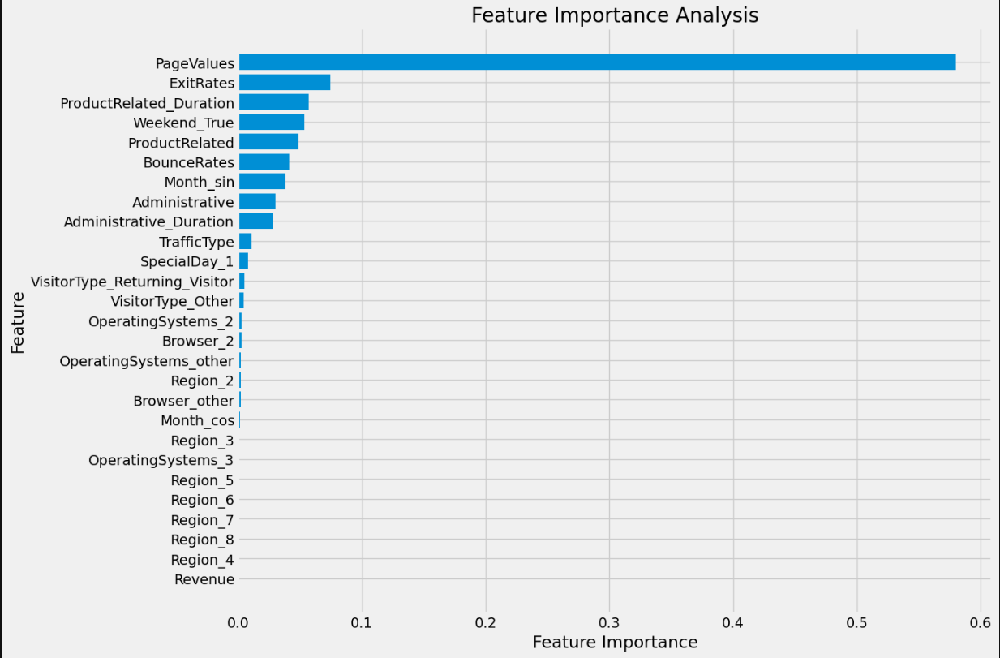
Explainable AI

Slide 12
Conclusion and Recommendations
Insights:
Bounce Rates and Exit Rates are correlated: Increase in one leads to an increase in the other.
Higher Page Value correlates with higher likelihood of purchase.
Returning visitors are more likely to make purchases.
Recommendations:
Offer vouchers to customers exhibiting extensive browsing behavior.
Provide special vouchers to returning visitors who have shown interest in specific items or categories.

Slide 13
Thank you

Slide 14
APPENDIX

Slide 15
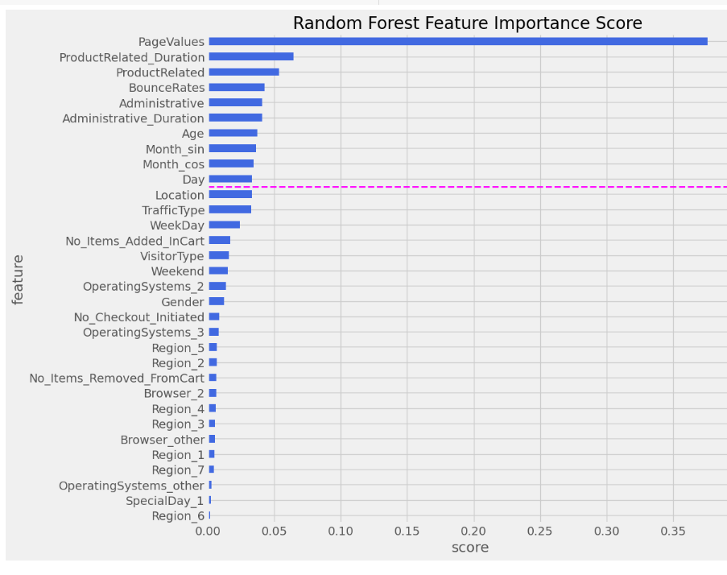
Feature Importance

Slide 16
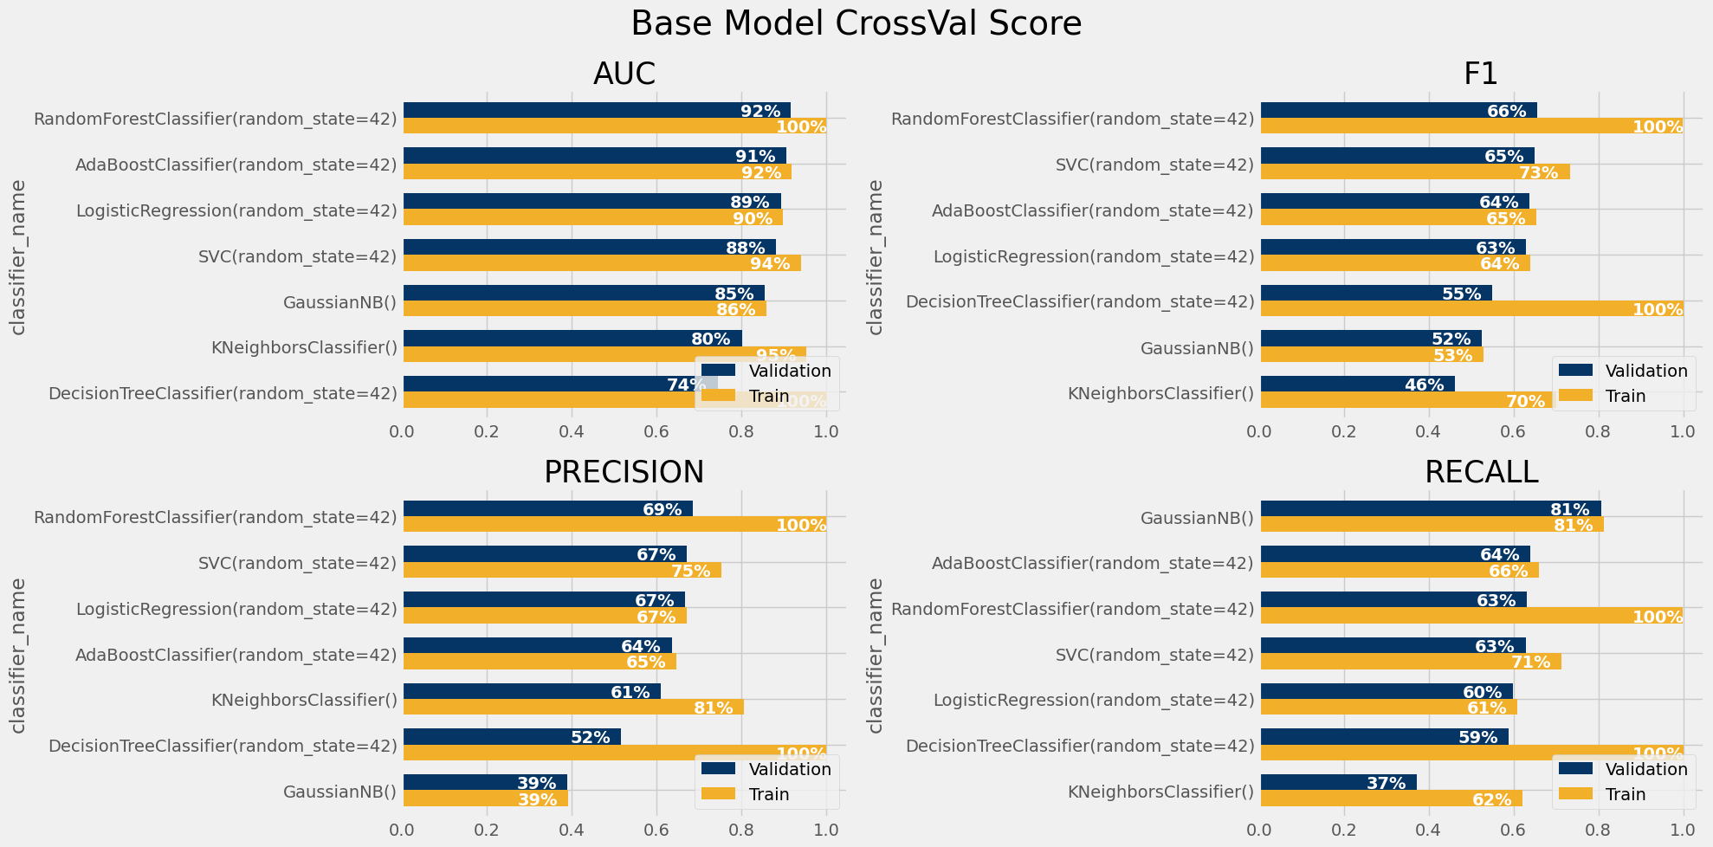
Base Model Scores

